Slide 1
LACE Score as a predictive tool to reduce unnecessary readmissions
Presented by: Stephen Pun & Erik Storm

Slide 2
Preliminaries
The LACE score is a validated tool to identify patients at risk for unplanned hospital readmission, based on previous admission history and known comorbidities.
Improve discharge and transfer-of-care planning.
Objective is to briefly explain the LACE model, and its potential to improve patient care and value delivery within our Enterprise.
Notes:
Briefly introduce the concept
“Over the next 15 minutes I will introduce a risk score that will help us predict the risk of inpatient readmissions. I will lay out the need for change, introduce you to the model, and discuss how you will play a role in the success of this effort.”
I frequently see analysts spend too much time setting the stage and defining the need for change (next section). Do not fall into this trap. You will run out of time and lose your opportunity to explain the model and how it will help!

Slide 3
Why do we need to change?
Hospital readmissions are costly from both a public health, and organizational perspective.
Estimated 11% of 30-day readmissions are preventable.
13.6% for Medicare
Annual aggregate costs $25B
Current BigMed Health System readmission rate: 15%
Annual aggregate costs $2.6M
Currently have no mechanism in place to identify patients at risk for readmission and to potentially intervene.
Notes:
Spend a few minutes establishing a fact based need for change. Use existing organizational performance metrics, published studies, and current organizational problems to frame the need for change. Do not introduce editorial or build connections to the future yet. You are using facts to explain the current state.
Again, spending too much time justifying the need for change is the most common analyst presentation trap I witness! Your audience already knows the problems if they work inside the organization. Use this to pinpoint which specific pain points your model will help address.

Slide 4
Impact of not changing
Financial:
Penalties (CMS / HRRP)
Lose market share to competitors
Public Health:
Missed opportunity to improve care to vulnerable populations
Damage to corporate image/reputation
Notes:
Build the connection between inaction and the future state with a focus on building the emotional need for change. Connect current problems to likely / plausible future consequences.

Slide 5
The LACE Score
Developed by Ottawa Hospital Research Institute
Score range 1-19
L length of stay
A acuity of admission
C comorbidities
E Number of ED visits in past 6 months
Notes:
SUMMARIZE
Validated index to assess patient risk of death and readmission after being D/C’d from hosp to community

Slide 6
L
A
Length of Stay
Acuity
DAYS | SCORE
1 | 1
2 | 2
3 | 3
4-6 | 4
7-13 | 5
14+ | 7
3
0
Admitted
through ED
Not via ED
Notes:
Length of Stay: INCLUDES day of admission & D/C

Slide 7
C
E
Comorbidities
# ED Visits in past 6 months
Peripheral Vascular
Disease
Dementia
Charlson Comorbidity Index
290.x, 294.1, 331.2 → 13.5%
Add 294.2, 294.8, 331.0 → 90.2%
Both
1
3
5
ED Visits | SCORE
1 | 1
2 | 2
3 | 3
4+ | 4
Notes:
14 possible comorbidities, chose 2
PVD: Many readmits due to vascular disease, higher propensity for decomp
Dementia: weighted heavier, wanted to capture range of , better discriminate
The most high risk patient: PVD + dementia, with many recent ED visits, now admitted again through the ED, and staying for at least 14d.

Slide 8
LACE Score Predicts Readmissions
Using our historical patient data from EHR
Dataset: all hospital admissions from Jan 1, 2014
90% for training
10% for testing
Logistic regression model
LACE score is significant predictor of readmission (p-value < 2 x 10⁻¹⁶)
For each LACE score increase of 1 point, odds ratio increases by 1.25
Notes:
We wanted to find out how well this LACE score predicts readmissions in OUR pts.
We used that dataset to build a logistic regression model to see whether or not the LACE score predicts readmissions. As it turns out, YES IT DOES.
What does this mean practically? Let’s compare two patients at the extremes, one with LACE score of 19 and one with LACE score of 1. The odds of the patient with LACE score of 19 being readmitted within 30d of D/C is 54 times that of a patient with a LACE score of 1.
exp(0.2215958*18)

Slide 9
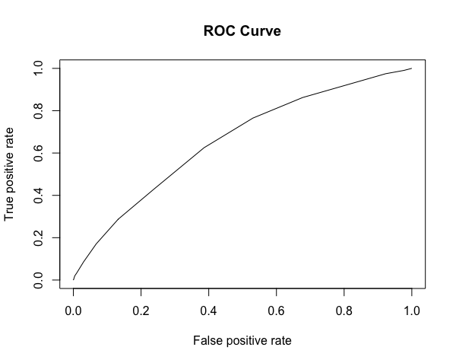
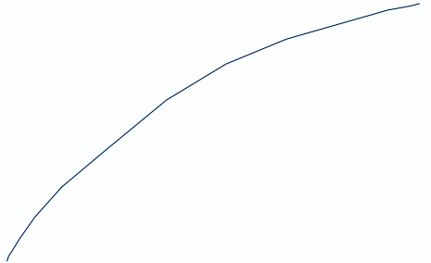
What about novel admissions?
AUC | 0.6584
ACCURACY | 71.3%
SENSITIVITY | 42.7%
SPECIFICITY | 76.4%
Notes:
Goal: Minimize false positives

Slide 10
# readmissions
5169
2962
42.7% reduction
ANNUAL COSTS
SAVINGS USING LACE SCORE
$2.6M
$1.1M
Notes:
Total adm = 34.5k
2k pts:
not subjected to financial burden of hospitalization
Not exposed to the many risks a/w from being an inpatient
Healthier and more satisfied with the care we provide
Who are not incl in our CMS reports

Slide 11
The LACE Score
Would be integrated into the discharge/transfer planning flowsheet in our EMR, and on both inpatient and outpatient summary screens.
Workflow:
Patients identified by LACE during discharge/txfr planning by care team:
Providers, nursing, discharge planning/social work
Patient flagged for f/u
Ensure adequate resources available at home/NPOC
Phone call f/u by nurse within 3 days of discharge
Ensure outpatient f/u with PCP within 7 days of discharge
Impact:
Avoiding readmissions of sicker patients through prospective intervention may secondarily impact other quality metrics.
reduce overall LOS, mortality?
Cost of implementation < < readmission
Notes:
Measures of impact: cost/day, how a successful impact of LACE implementation affects other measures

Slide 12
Leadership Role
•Request support of this project, and priority for funding.
–Project sponsored by CMIO
–Direct finance to allocate appropriate resources
–Direct CIO to allocate personnel resources (PM, analysts, SME’s).
–CMO and CNO to identify champions
•The successful implementation of this project will positively affect BigMed Health both financially, and by improving the care to those patients who need us the most.
Notes:
End with action!
Specifically detail what you need your audience to do in order to make this effort a success.
Think of this as the positive benefits that offset the negative consequences you highlight earlier.
Leave your audience with a clear sense of what they need to do individually to drive success when the leave the room.

